Slide 1

Healthcare - Persistency of A Drug
Data Science Project
Batch code: LISUM20
30th June 2023

Slide 2
Project Team Group Name: Ensemble Elites
Name | Email | Country | College/Company | Specialization
Nwankwo Ezinne Anasthecia | nwankwoanasthecia@gmail.com | Nigeria | Freelance | Data Science
Bindu Musham | Bindu.musham@gmail.com | USA | The University of Texas at Dallas | Data Science

Slide 3

Agenda
Executive Summary
Problem Statement
Approach
EDA
EDA Recommendations
Model Building
Model Evaluation
Conclusion

Slide 4
Executive Summary
ABC Pharma is facing a significant challenge in understanding the persistency of drug usage as per physician prescriptions. The persistency of drug usage refers to the extent to which patients continue to take their prescribed medications over a specific period of time.
Currently, ABC Pharma Company relies on manual methods to track and analyze drug persistency. This involves reviewing patient records, conducting surveys, and relying on self-reporting, which can be time-consuming, prone to errors, and lack real-time insights.
To address this challenge, ABC Pharma Company has decided to approach an analytics company to automate the process of identifying drug persistency. The goal is to develop a data-driven solution that can accurately and efficiently track patients' prescribed medication usage, enabling ABC Pharma Company to gain valuable insights into medication adherence patterns.

Slide 5
Problem Description
One of the challenge for all Pharmaceutical companies is to understand the persistency of drug as per the physician prescription. To solve this problem ABC pharma company approached an analytics company to automate this process of identification.
ML Problem:
With an objective to gather insights on the factors that are impacting the persistency, build a classification for the given dataset.
Target Variable: Persistency_Flag

Slide 6
Approach
Data Collection
Data has been collected from Kaggle
https://www.kaggle.com/code/crucifer/houseloan-data-analysis/data
Exploratory Data Analysis
Data Description
Univariate Analysis
Data Preprocessing
Imputing missing values
Scaling using minmaxscaler
Bivariate Analysis
Train/ Test split
Model Building
Tested few models
Best model is selected
Feature Selection
Model optimization
Reduced feature subset
Hyperparameter tuning to improve the model performance scores

Slide 7
Description of Numerical Features
 | Dexa_Freq_During_Rx | Count_Of_Risks
Count | 3424.000000 | 3424.000000
Mean | 3.016063 | 1.239486
Standard Deviation | 8.136545 | 1.094914
Min | 0.000000 | 0.000000
25% | 0.000000 | 0.000000
50% | 0.000000 | 1.000000
75% | 3.000000 | 2.000000
Max | 146.000000 | 7.000000

Slide 8
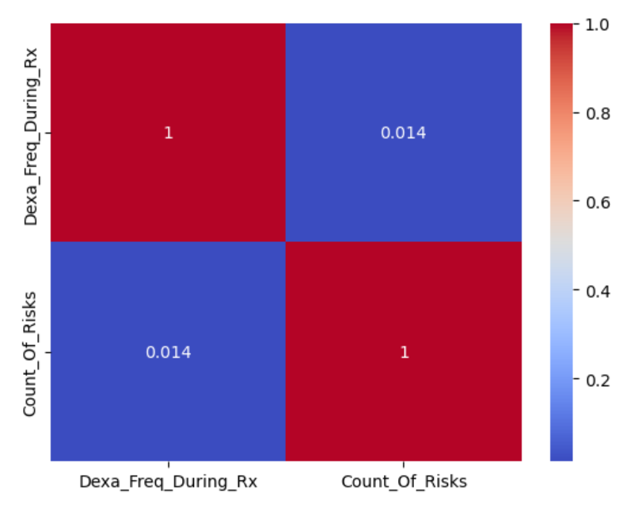
Correlation Between Numerical Features
The correlation between the count of risks and Dexa frequency during Rx is 0.014, which is very weak. It means the count of risks and dexa frequency during Rx have very little or nothing in common which means they can exist independently of each other. In other words, they affect drug persistency independently.

Slide 9
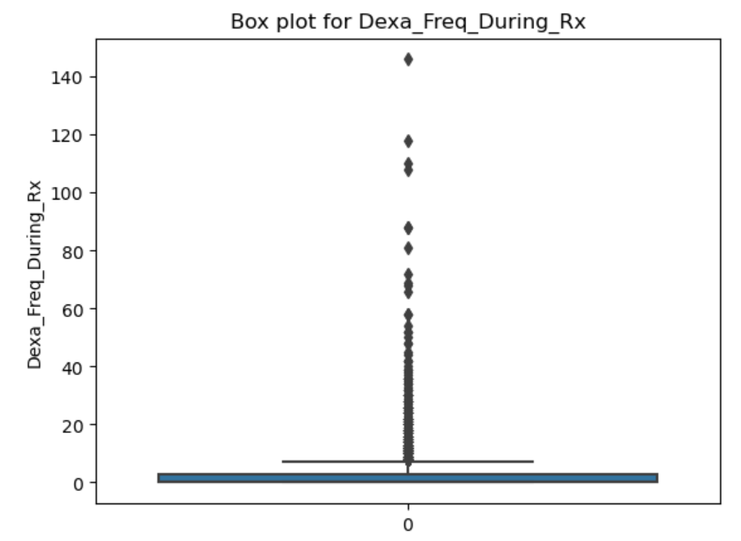
Box Plot of Dexa Frequency during Rx
The box plot was used to detect outliers from the dataset.
After the outliers were detected in the Dexa_Freq_During_Rx column and dropping them, the new result of the dataset shape shows that 460 outliers were detected and dropped. Dropping the outliers helps to reduce bias in the results obtained.

Slide 10
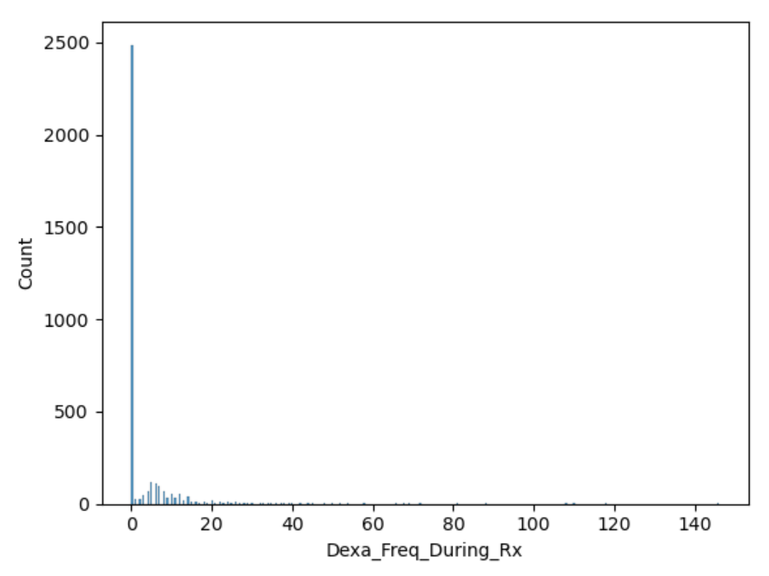
Histogram of Dexa Frequency During Rx
From the plot, it indicates that the data has a concentration of values on the left side (lower values) and a few extremely high values that pull the mean towards the right. The tail of the distribution extends towards the higher values, indicating the presence of outliers or extreme values in the dataset.

Slide 11
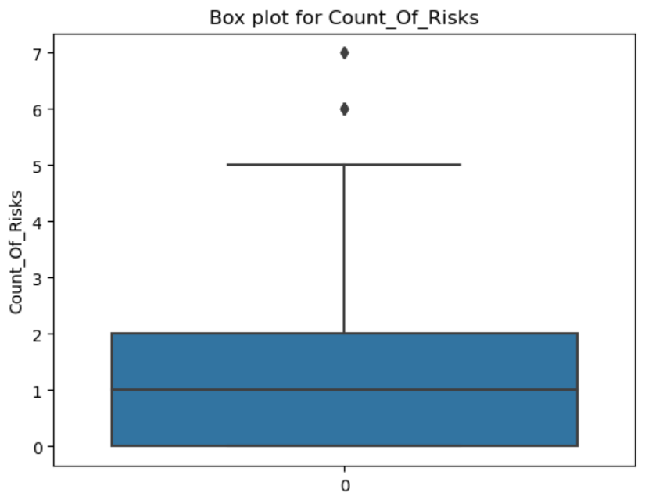
Box plot of Count of Risks
After dropping the outliers in the Count_Of_Risks column, it is discovered that there were 8 outliers of values 6 and 7.

Slide 12
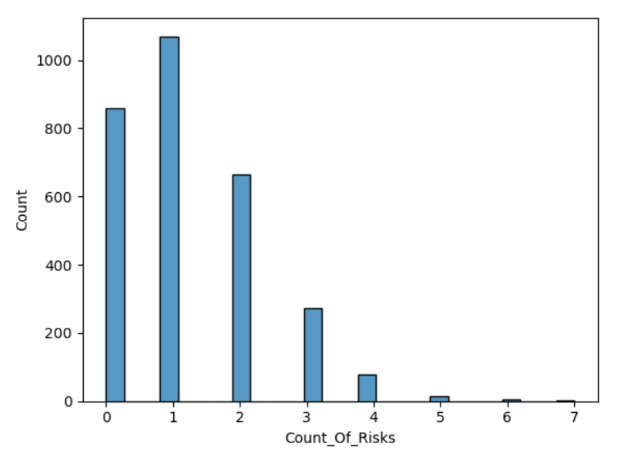
Count of Risks Frequency
It indicates that the distribution has a longer tail on the right side and may have some outliers or extreme values on the higher end. However, the skewness is not significantly large, indicating a relatively mild departure from symmetry.

Slide 13
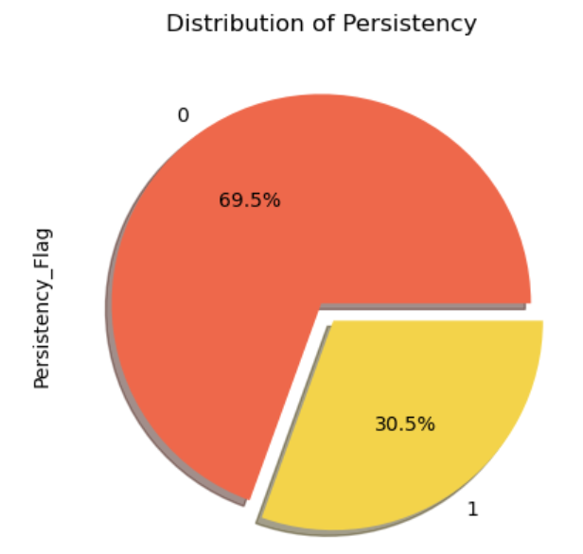
Persistency Percentage Distribution
From the pie chart, it can be deduced that the percentage of non-persistent patients is more than the percentage of persistent patients with values of 69.5% and 30.5% respectively.

Slide 14
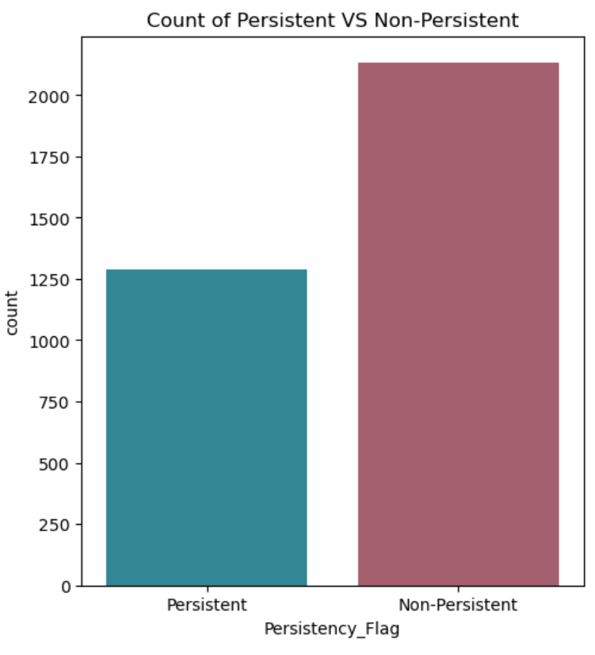
Count of Persistency
From the count of persistency, it can be seen that the number of non-persistent drug users are 2053 while the number of persistent drug users are 903.

Slide 15
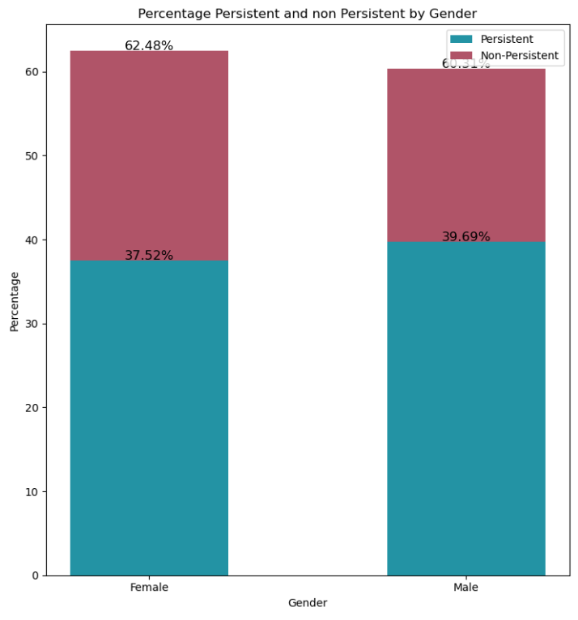
Persistency Percentage by Gender
The percentage of non-persistent female (69.77%) is higher than the percentage of non-persistent male (64.37%). Evidently, the males are more persistent than females.

Slide 16
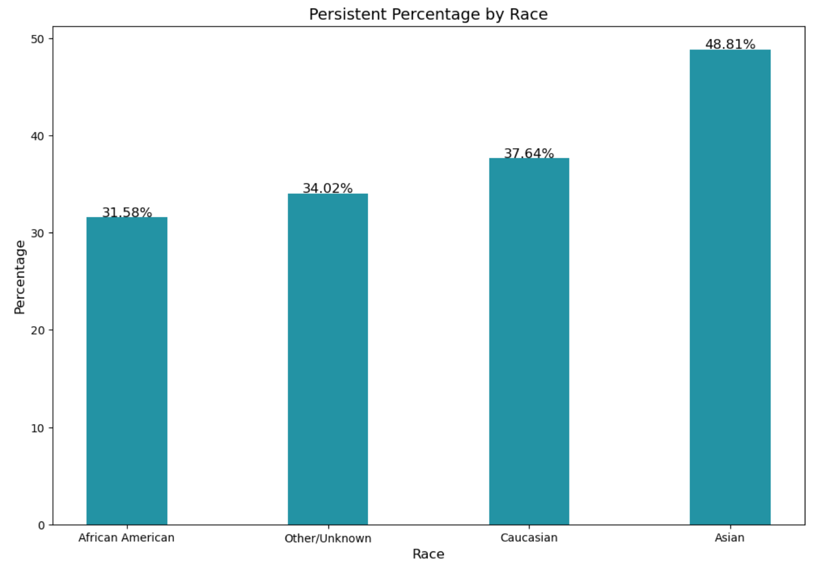
Persistency Percentage by Race
The highest percentage(48.81%) of patients who are persistent in taking prescription drugs is among Asians, while the lowest percentage of persistent patients is among African Americans(31.58%).

Slide 17
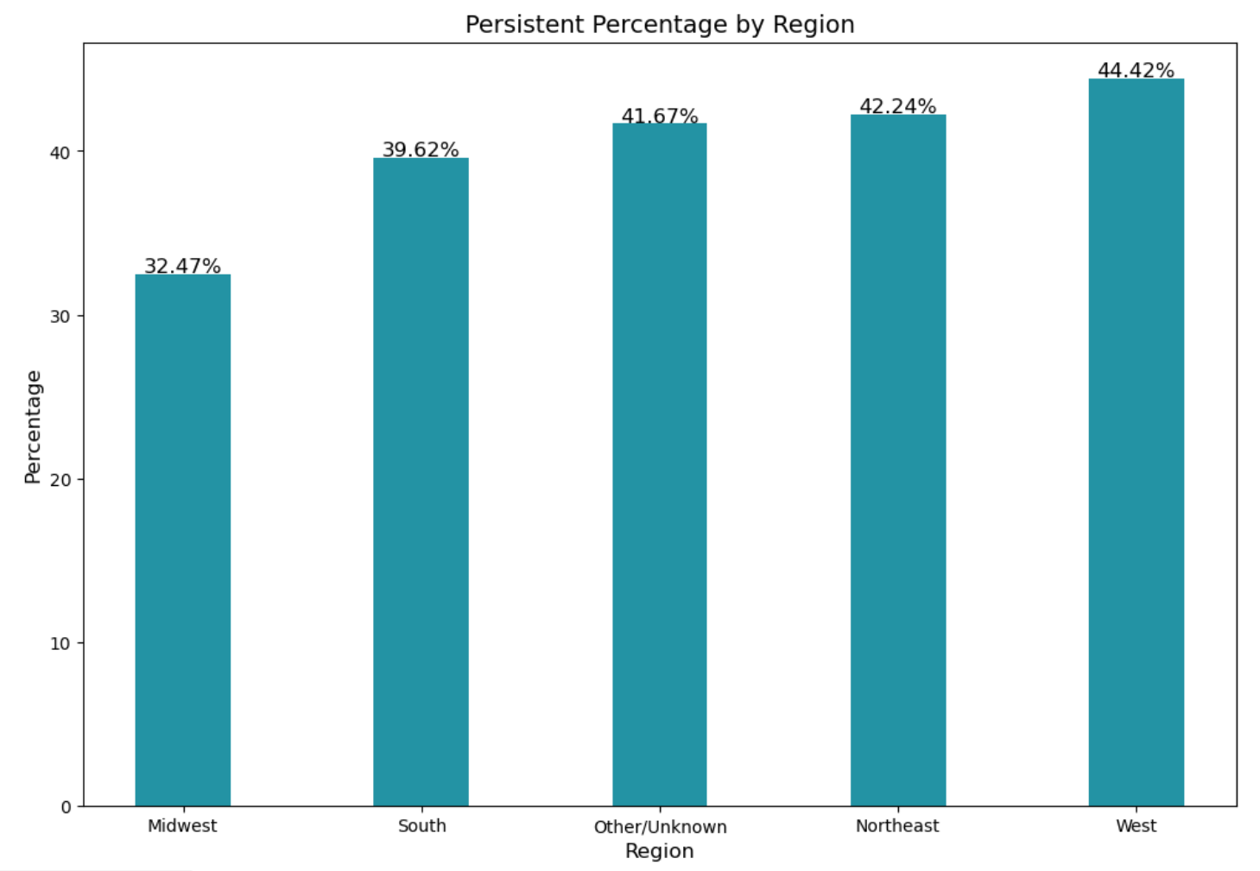
Persistency Percentage by Region
The highest percentage of persistent patients i.e., 44.42% are from West region and lowest persistent patients i.e., 32.47% are from Midwest. The persistent customers are 12% higher from West when compared to Midwest.

Slide 18
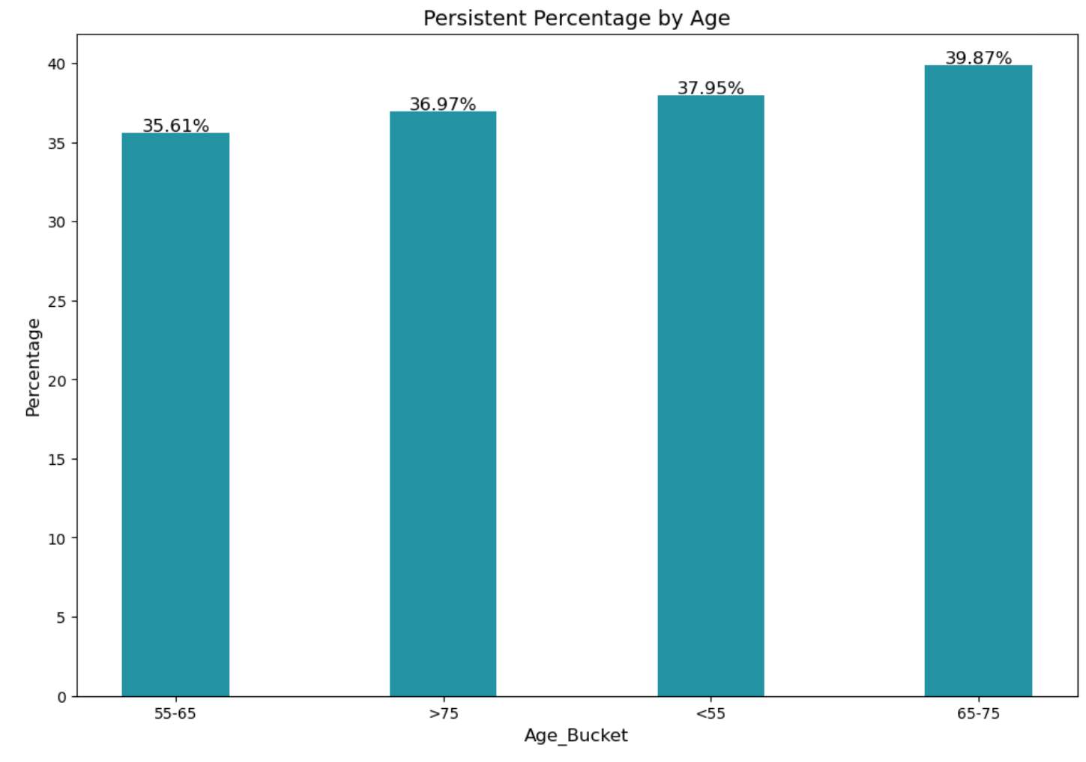
Persistency Percentage by Age
There is no much difference between Persistent patients across different age buckets. Highest persistent are of age group 65-75 and lowest in the age group of 55-65.

Slide 19
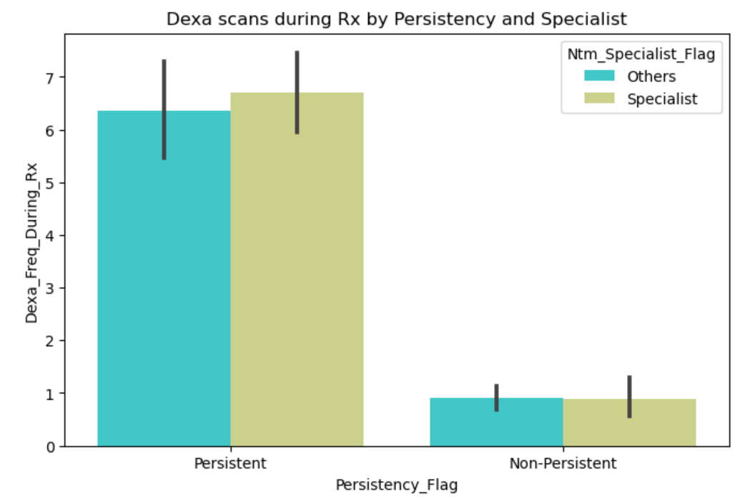
Dexa Scans during Rx by Persistency and NTM Specialist Flag
Dexa scans during Rx are high for persistent patients who got prescribed by NTM Specialist. There is no significant difference for NTM Specialist and others in Dexa scans for non-persistent patients.

Slide 20
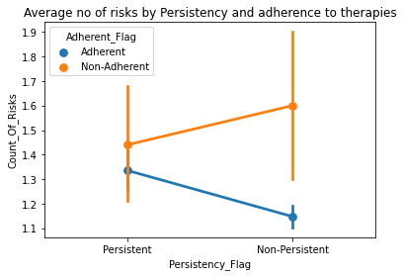
Count of Risks by Persistency and Adherence Flag
 | The count of risks for Persistent patients are high for Non-Adherent and low for Adherent patients. Similarly, for Non persistent patients, the count of risks are high when patients are non adherent.

Slide 21
EDA Recommendations
Increase the persistency rate for female patients by providing some special discounts or coupons as they are high in filling prescription drugs.
Higher advertising and marketing in Midwest may increase the persistent rate.
The patients who got prescribed by NTM Specialist have more dexa scans during Rx. So, if we target NTM Specialist prescription drugs, the persistency rate will increase.
The number of risks are high for patients who are not adherent to therapies. We can give extra therapy sessions to attract non adherent patients to reduce risks and increase persistency.
In order to increase sales and profitability for ABC Pharma company, it is important to improve the persistency rate over time. By increasing the persistency rate, the company can achieve higher sales of prescription drugs and ultimately generate more profits.
Increased attention should be paid to patients from the age bucket of 65 and above because they are less persistent in drug usage.

Slide 22
Data Preprocessing
There are outliers for Dexa_Freq_During_Rx (number of DEXA scans taken during Rx) and Count_Of_Risks (count of risks). Identiﬁed Outliers using Inter Quartile range & Box plot and removed the outliers.
Deleted Ptid (Patient id) which is not an important feature to understand factors aﬀecting persistency of a drug.
Numerical Features
Imputing missing values with median
Scaling is performed using minmax scalar
Categorical Features
Imputing missing values with most frequent category
One hot encoding is performed to convert the categorical values to numerical
Train/Test split-70%/30%
Evaluation Metric: ROC_AUC score

Slide 23
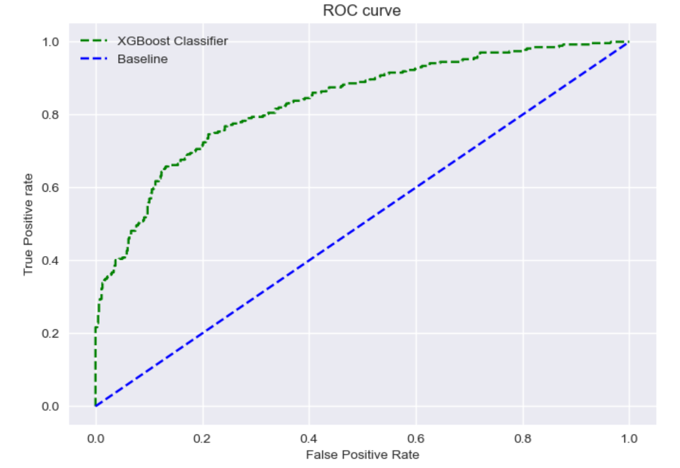
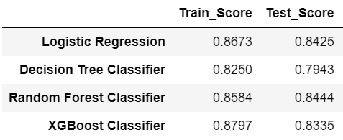
Model Evaluation
Tested Models
Logistic Regression
Decision Tree
Random Forest Classifier
XGBoost Classifier
XGBoost Classifier is the best fit model with higher roc_auc score.

Slide 24
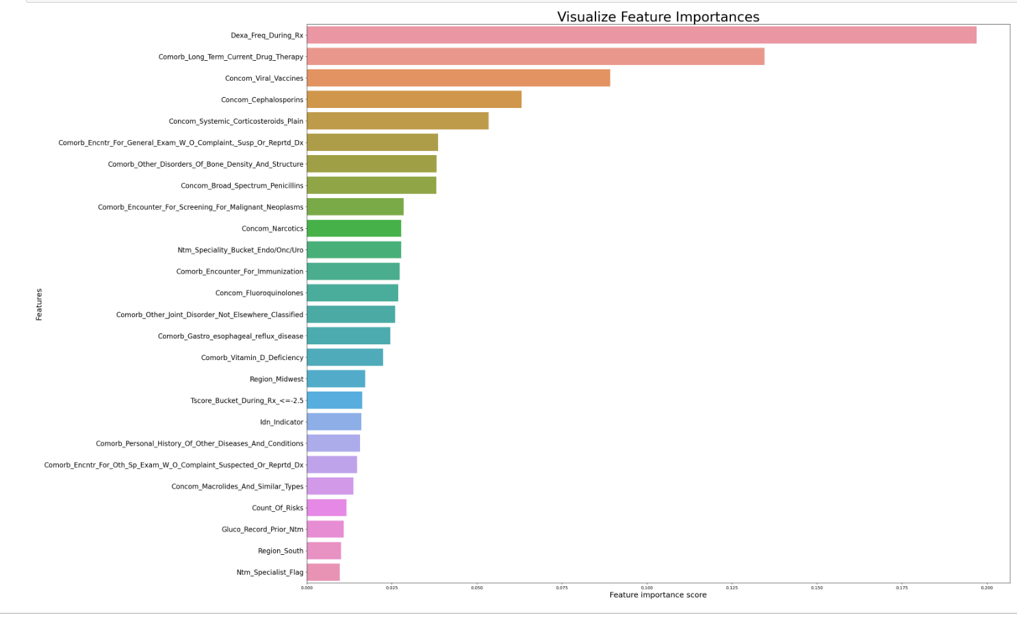
Feature selection

Slide 25
Model Optimization
Hyperparameter tuning has been performed
Best model parameters are selected
Fitted the selected parameters and selected features to the model
Final performance score is 0.834 roc_auc for the test dataset

Slide 26
Conclusion
Targeted promotions and marketing based on Gender, Region, Race and patient history can increase sales and profits of ABC Pharma company.
Persistency of a drug is a classification problem and we have tried different models.
XGBoost Classifier is the best model with final ROC AUC score of 0.834

Slide 27
Thank You

